Slide 1


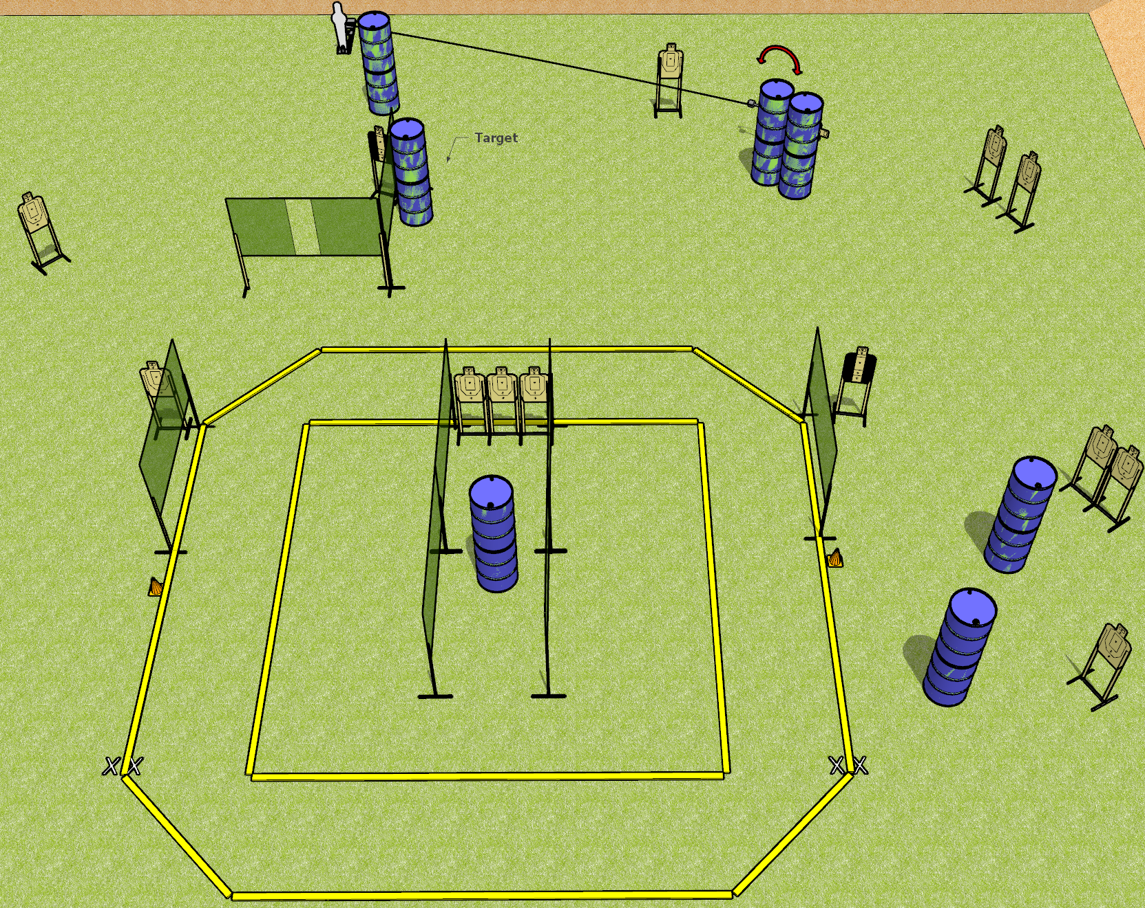
 | Dothan Gun Club – USPSA Match Square Peg Course Designer : Drew Coleman
START POSITION : Standing with both feet on either set of X’s, wrists below belt
GUN READY CONDITION : Pistol loaded and holstered. PCC loaded, held with both hands, shouldered, safety on, pointed at either orange cone. |  | SCORING: Comstock, 31 rounds TARGETS: 15 paper, 1 Steel SCORED HITS: Best 2 on paper, steel until down START-STOP: Audible, last shot RULES:
STAGE PROCEDURE: Engage targets as they become available from within the fault lines.

Slide 2
Square Peg
Written Stage Briefing
Square Peg is a 31 round, 155 point, Comstock field course. There are fifteen USPSA targets and one pepper popper. The best two hits on paper will score, and steel must fall to score. The start signal is audible.
The swinger is activated by the pepper popper. Please check the activator prior to walkthrough and set it the same way every time for each shooter.
Handgun start position is standing with both feet on either set of X’s. Handgun is loaded and holstered.
PCC start position is standing with both feet on either set of X’s, muzzle pointed at either orange cone. Loaded carbine is held with both hands, shouldered, safety on.
On start signal, engage targets as they become available from within the shooting area.

